Slide 1
Dodge, Feast, Temperature
and Electric Fence (optional). ------By Hang (Yohan) Yu

Slide 2
Hypothesis
The agent under reinforcement learning algorithm should chase reward and avoid pain.
Under appropriate architecture, the agent is able to figure out a sustained strategy that leads to consistent results with high yield.
The agent is able to perform better than a human player after enough training.

Slide 3
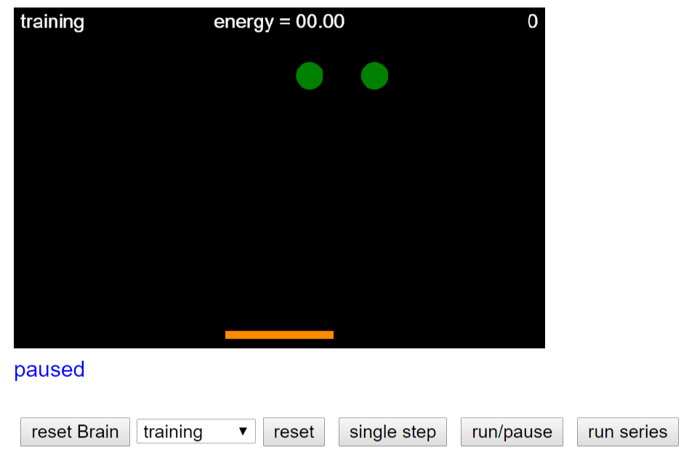
Review: Week 13 Homework--Reinforcement Learning with Neural Nets

Slide 4
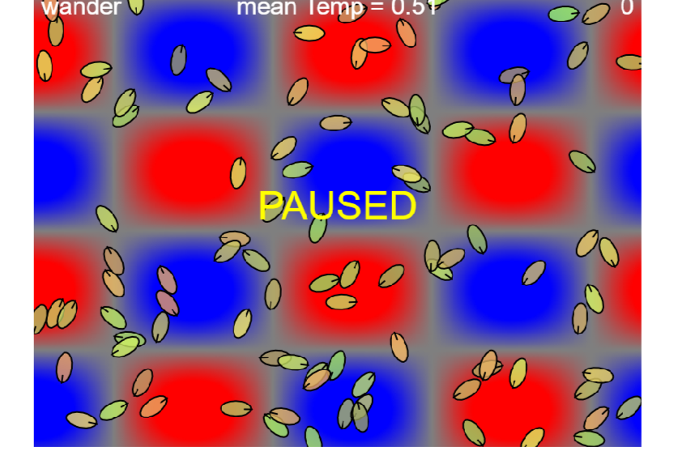
Review: Week4--bacterial run-tumble behavior
So the idea is to combine features form HW4 and learning algorithm from HW13
But in my case, one bot is enough.

Slide 5
Milestone 1: mod HW13 complete!

Slide 6
Milestone 2: enable a human player!

Slide 7
Milestone 3: deadly electric fence (fun)!

Slide 8
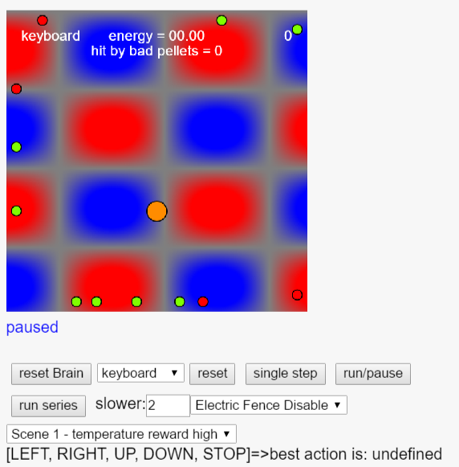
Milestone 4: GUI fully completed!

Slide 9
Model
The agent has 12 sensors.
"north, south, west, and east" on edges of the agent.
There is one sensor called "wall“ (it is only used when electric fence is enabled).
And there is one sensor for temperature.
The rest two are a little bit tricky: they are called ”close” (it helps the agent identify pellets that are close enough to chase/avoid).
The agent has 5 actions: [up,down,left,right,stop]
The agent moves at peak speed of 2.5 units per frame.
The agent learns by neural network with Q-learning.

Slide 10
Demo time: Round #1 Human player
Score: 220+-10

Slide 11
Learned HOT HACK, forgotten PELLETS
Scene 1: 0.125 energy per frame from HOT == 250 maximum energy from temperature in 2000 frames
Score: 180 +-15 (50 test trials)
Interesting!
Let’s make temperature less influential.
Model:
1 hidden layer
20 neurons
Sigmoid
Learning_rate = 0.01
Batch: 50

Slide 12
Still falling in love with HOT HACK!
Scene 1: 0.025 energy per frame from HOT == 50 maximum energy from temperature in 2000 frames
Score: 45 +-10 (50 test trials)
Model:
1 hidden layer
20 neurons
Sigmoid
Learning_rate = 0.01
Batch: 50

Slide 13
Hypothesis=>Conclusion
The agent under reinforcement learning algorithm should chase reward and avoid pain. CHECK
Under appropriate architecture, the agent is able to figure out a sustained strategy that leads to consistent results with high yield. CHECK
The agent is able to perform better than a human player after enough training. ???(seemly not)
The agent is able to figure out the trick in achieving higher score (if there is one) CHECK

Slide 14
Q-learning to Top Performance is similar to Greedy algorithm to Dynamic Programming
Intuition Built:
Q-learning is beautiful and simple.
It might not learn to perform the best.
But it is committed to tricks (The same as in Atari:Breakout)

Slide 15
Lesson Learned:
Adding a grid search for near optimal parameters could be overwhelming. But epsilon-greedy could play a role (I think Shuyuan’s project could refute my idea).
Presentation is my weakest link. But through this time,

